Slide 1
IOT Based Substation Monitoring and Controlling System
Guided by :-Prof. A.S.Jhaybay

Slide 2
Abstract
This Project aim at implementing a web server over an AVR microcontroller. Now a days in a substation there is at least one operator for measuring parameter like voltage ,current, level and temp. etc. belonging to transformer and other equipment. These can affect the transformer and parallax error too. So by using, these project we can minimize error.

Slide 3
Content
Literature Survey
Hardware
Networking
Introduction
Project overview
Execution of project
Result and summary
Advantage and disadvantage
application

Slide 4
Project overview:-
Monitoring of substation as essential task for supplying healthy power to the consumers, there are transmission or distribution substations those supply electrical power to various loads. Remote controlling makes these substations to be operated through wireless communication technologies like zigbee etc.
In these project sensor are used to sense the parameter of transformer(level and temp.) .
Then these data is send to web server through communicating device Ethernet. Through the interface of webpage, a user can control devices attached to microcontroller.

Slide 5
BLOCK DIAGRAM OF PROJECT
Microcontroller AT mega32
Level sensor
Ethernet(ENC28160)
Temp. sensor
Web Server

Slide 6
Literature Survey
Hardware study
Atmel AT mega32 microcontroller
ENC28J60 Ethernet controller
LCD display
NETWORKING

Slide 7
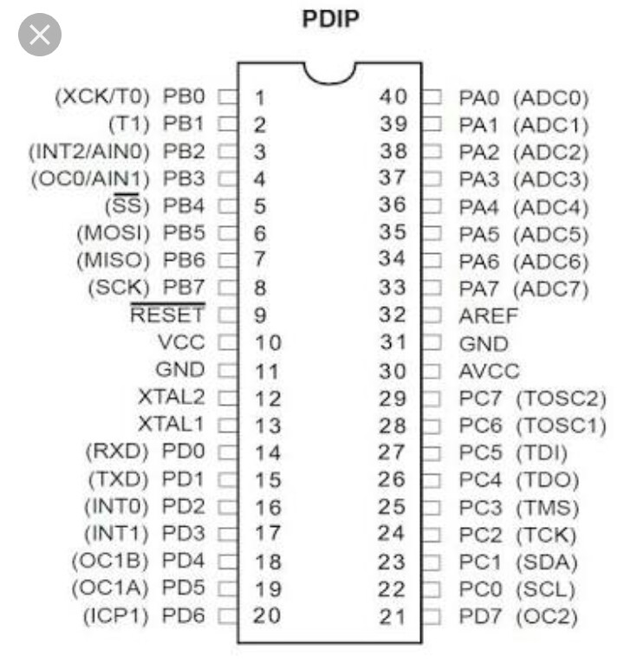
ATMEL ATmega32 Microcontroller
The Atmega32 is a low power CMOS8-bit microcontroller based on the AVR enhanced RISC architecture by executing powerful instruction in a single clock cycle.
ATmega32 Features :
1] CPU -8bit AVR
2]Two-8bit timer/counter with separate Pre scalers and Compare Modules
3]one sixteen bit timer/counter
4]on-chip analog comparator
5]External and internal Interrupt Sources
6]2k bite internal RAM
7]1024 bytes EEPROM

Slide 8
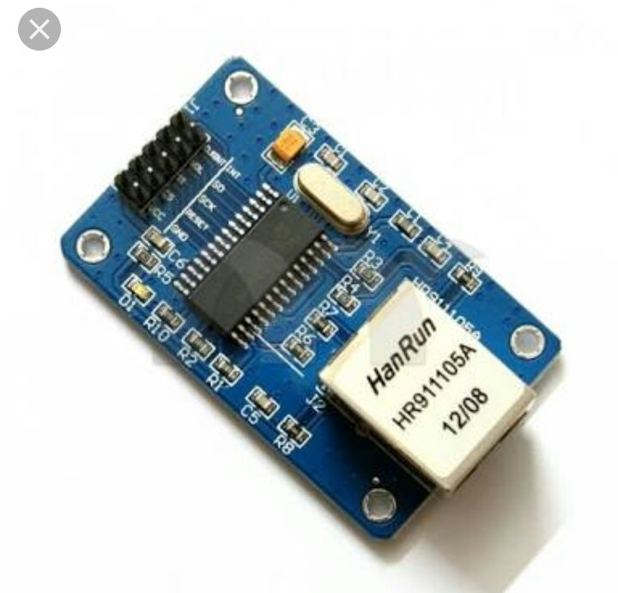
ENC28J60 Ethernet Controller
An Ethernet Controller is a device used to implement Ethernet Protocol . The reason for using ENC28J60 as an Ethernet Controller in our application is because its supports SPI Interfacing.
Features of Ethernet:-
IEEE 802.3 compatible
Supports full and half duplex modes
Programmbale automatic retransmit on collision

Slide 9
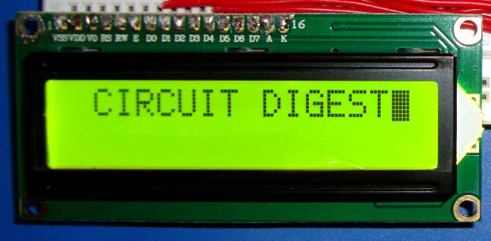
LCD Display
An LCD Display offers high flexibility
It may also used for debugging purpose
An LCD driver is a link between the microcontroller and LCD

Slide 10
NETWORKING
A network connects computers, mobile phone ,peripherals and even IOT devices.
we mention about points:-
Protocol stack
Ethernet frame structure
http

Slide 11
ADVANTAGES
Devices can be operated from any where in the world
Efficient and low cost design
Low power consumption
Real time monitoring
Wireless monitoring system
Fast control action
Automatic control action
Accurate system

Slide 12
DISADVANTAGE
Depends on network signal strength i.e. weak or strong.

Slide 13
APPLICATION
In industries to monitor different modules located at different places
In rural areas which are far away from main station
Monitoring and controlling of home appliances
Distribution points where the huge amount of power distribution takes place
Automation of any small areas where many electrical devices are present can be done
For e.g. process controlling unit

Slide 14
FUTURE EXPANSION
The project can be extended by using GPRS technology , which helps in sending the monitored and control data to any place in the world

